Slide 1
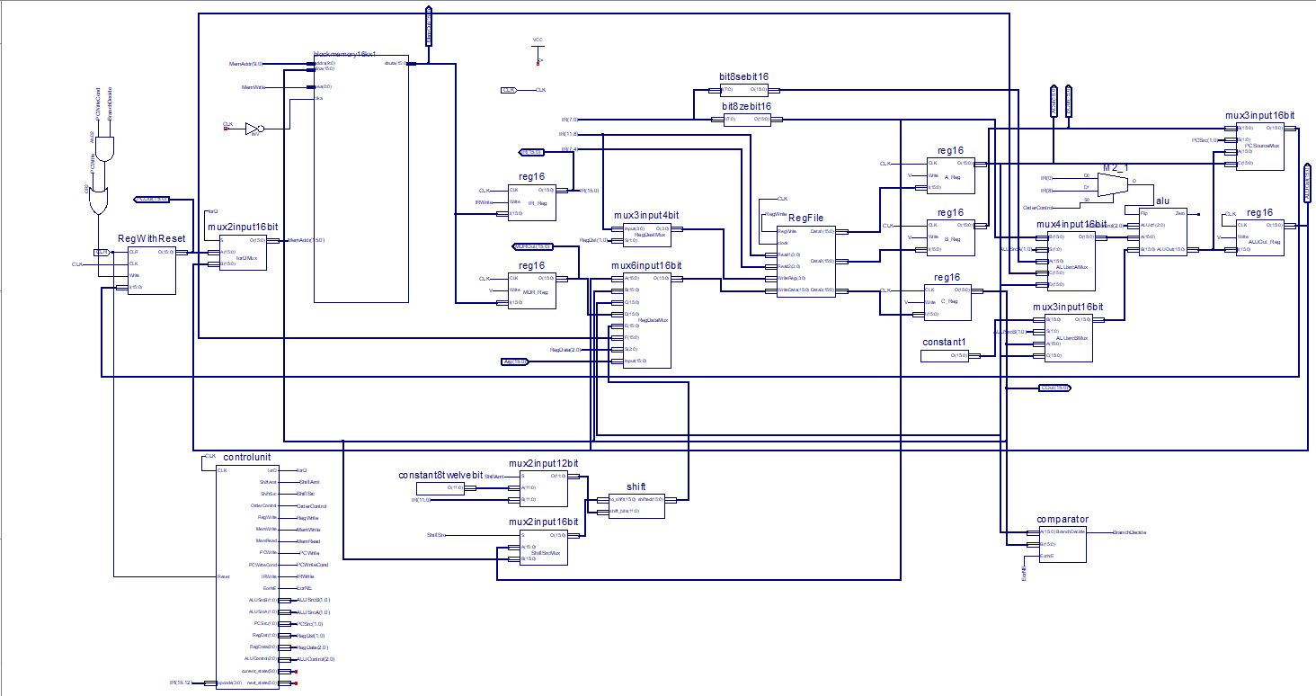
Accumulators and Registers 3.5E
By: Caleb Donoho,
Brian Jennings,
Anderson Yang,
Kevin Wang,
Kaiyu Xie

Slide 2
Type of Processor
Accumulator/ Load Store hybrid
16 Registers, exactly 16 instructions
Assembler allows it to be programmed much like a MIPS load store processor using pseudo instructions.
Multi-cycle
I/O
Notes:
Brian Jennings
-Much like MIPS
-Filled all 16 possible instructions, added more through psuedo instructions
-Multi-cycle
-Added input and out put to make the processor more simple to use

Slide 3
Register Names and Availability
Reg #0 - $0: A register that always contains 0. Reg #1 - $acc: The accumulator register. Reg #2-5 - $a0-3: argument temporary registers. Reg #6-7 - $v0-1: return temporary registers. | Reg #8-9 - $t0-1: temporary registers. Reg #10-11 - $s0-1: safe registers. Reg #12 - $ra: A register which contains the return address. Reg #13 - $sp: A register which contains the stack pointer. Reg #14-15 - $at0-1: Assembler temporaries.
Notes:
Yuankai Wang
Most parts similar to MIPS. But we only have 16 positions for registers, so we need to throw something off.
Some things that are important, we will still need to keep them, like $ra, $sp, argument and returns. We keep the $0 to make the code easier.
$acc shows our design of accumulator. Handle most of the calculations. Many instructions have a default to calculation, load or store to the register.
So we can cut down the number of temporary registers we need.
We used two assembler temporaries to allow us to use more complex pseudo instructions. Therefore, we will feel much easier when we write assembly code.

Slide 4
Instruction Types
op | reg | imm/unused
Type I:
4 bits 4 bits 8 bits
op: Basic operation of the instruction.
des: The register/accumulator destinator operand
imm: immediate value that represents a constant value or an address in memory.
Type II:
4 bits 4 bits 8 bits
op: Basic operation of the instruction
imm: immediate value.
Type III: For beq and bne
4 bits 4 bits 4 bits 4 bits
op: Basic operation of the instruction
op | imm/unused | imm
op | reg | des | unused
Notes:
Kaiyu Xie reserved:D

Slide 5
Instruction List
add: Type I instruction with opcode 0 0 sub: Type I instruction with opcode 1 1 lmem: Type I instruction with opcode 10 2 Takes the value at a register, adds the immediate to create a memory address, then gets the value from memory and puts it in the accumulator smem: Type I instruction with opcode 11 3 Takes the value at a register, adds the immediate to create a memory address, then sets the memory at the location to the value in the accumulator beq: Type III instruction with opcode 100 4 bne: Type III instruction with opcode 101 5 | sll: Type II instruction with opcode 110 6 slt: Type I instruction with opcode 111 7 or: Type I instruction with opcode 1000 8 and: Type I instruction with opcode 1001 9 lui: Type II instruction with opcode 1010 A jr: Type I instruction with opcode 1011 B jal: Type I instruction with opcode1100 C ori: Type II instruction with opcode 1101 D lacc: Type I instruction with opcode 1110 E Load value in specified register into the acc sacc: Type I instruction with opcode 1111 F Store value in acc to given reg
Notes:
Kaiyu Xie reserved:D

Slide 6
Instruction Pattern
Procedure Calls
Back up all s registers and any others needed including $ra, restore when finished
$a0 - $a3 will be used to hold arguments
$v0 - $v1 will be the outputs of the procedure call
Translate to machine code
For logical instructions it will zero extend, for arithmetic it will sign extend
For opcodes and registers, it will zero extend to 4 bits.
For beq, bne, jr, and jal we use direct addressing, meaning it will go to the address in the register specified.
Notes:
Caleb Donoho
Notes:
Procedure Calls
Start out by mentioning that it is similar to the MIPS procedure
The safe registers, $s0-1, must be backed up and restored such that they are always safe to use.
$ra must be saved and restored in order to be able to return up the chain upon completion
We designed the 4 argument registers to hold any arguments that needed to be passed into procedures.
We didn’t think any procedures would need more than one return value, but we put in two return registers just in case.
Translation to machine code using the assembler
The assembler first looks for any pseudo-instructions and converts them to regular instructions
It then finds where all the tags are and stores them away
It adds code to set up the stack pointer
It converts all the mentions of tags in the code to binary memory locations
It converts the list of now all regular instructions to binary using our instruction structure convention

Slide 7
RTL
Logical/Arithmetic/ Slt | sacc/lacc | lmem/smem | sll | beq/bne | lui | jal/jr
IR = Mem[PC] PC = PC + 1
C = Reg[1] A = Reg[IR[11-8]] B = Reg[IR[7-4]] ori: order = IR[8] Otherwise: order = IR[0]
ori: Use ZE[IR[7-0]] instead of A if(order == 0) ALUOut = A op C Else ALUOut = C op A | sacc Reg[IR[11-8]] = C lacc: Reg[1] = A | ALUOut = A+ SE(IR[7-0]) | Reg[1] = C<<IR[11-0] | beq: if(A==C) PC=B bne: if(A!=C) PC=B | Reg[1] = ZE(IR[7-0])<<8 | jal: Reg[12]=PC jr and jal: PC=A
Reg[1] = ALUOut |  | lmem: MDR = Mem[ALUOut] smem: Mem[ALUOut] = C
 |  | lmem: Reg[1] = MDR
Notes:
Caleb Donoho
We designed the RTL by taking each instruction and writing out the RTL individually
We then grouped parts of instructions together in order to simplify further
Parts that couldn’t be part of all the instructions were split up further until cycles were as grouped together as possible(in order to simplify the datapath

Slide 8
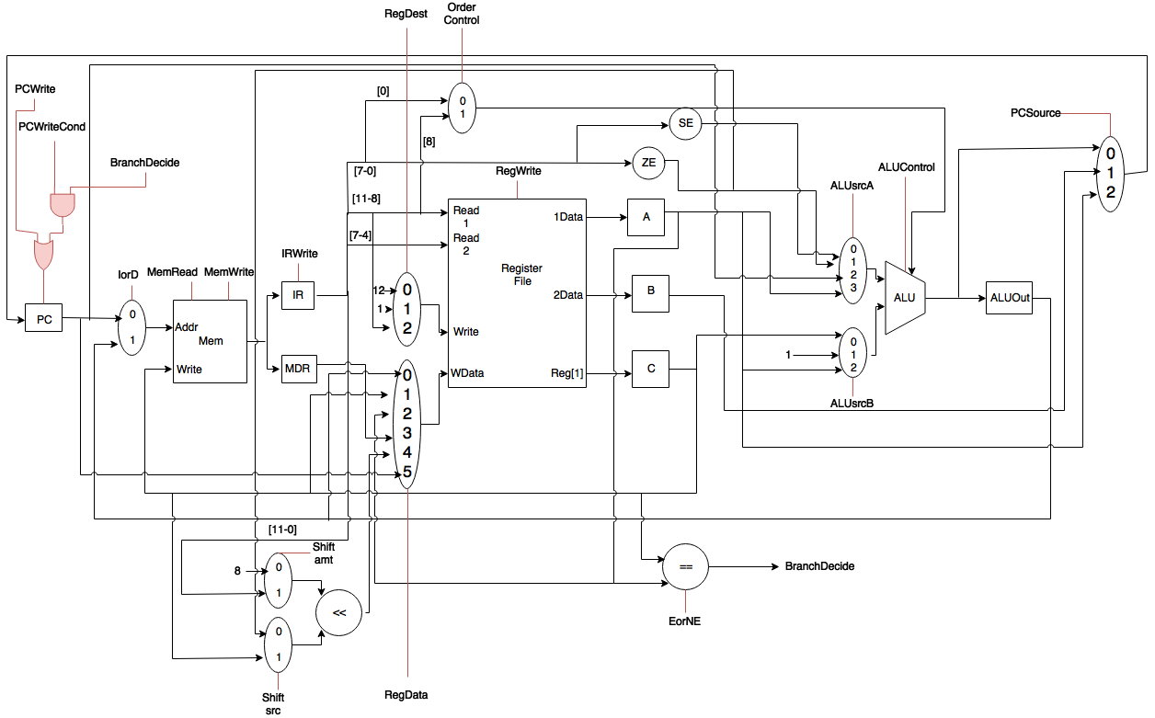
Datapath
Notes:
Caleb Donoho
We designed the processor in a similar fashion to how we designed the RTL
Take a cycle, draw out what was needed for that cycle
If there was part overlap, we consolidated into a simpler design.
Did this for all the RTL
Last step that came throughout the process was simplifying our muxes more so that there were fewer muxes thus fewer control signals
Unique parts we made
ALU order control
Variable shift left
Comparator

Slide 9
Control Signals
Standard Control Signals
Order Control
EorNE
ShiftAmt
ShiftSrc
Notes:
Brian Jennings
-talk about standard control signals
-explain what each of the other signals are used for in our processor.

Slide 10
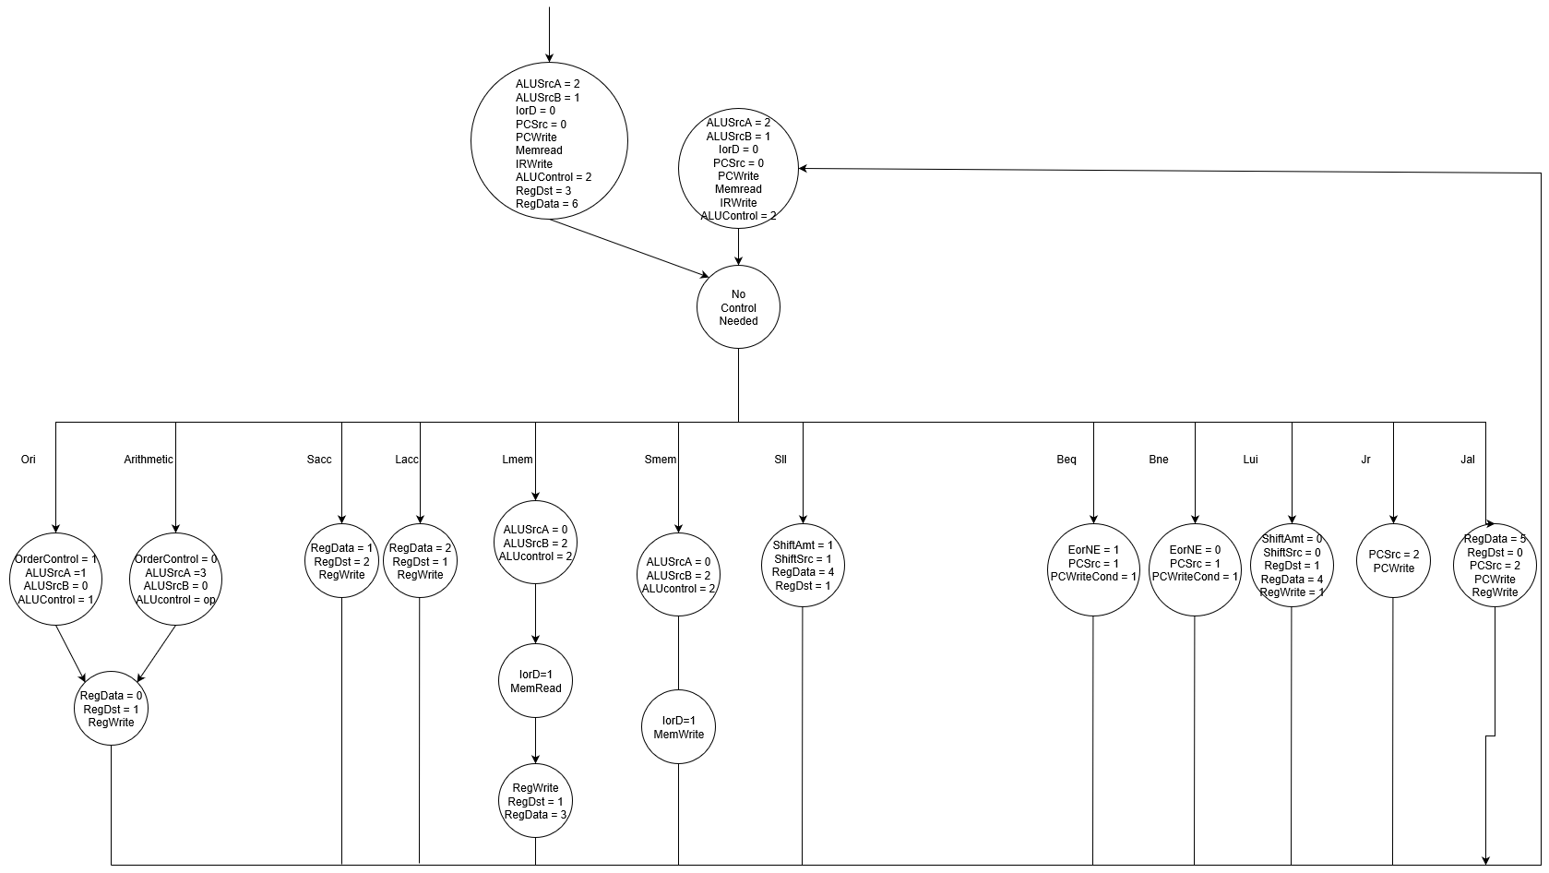
Control State Diagram
Notes:
Brian Jennings
-We got most things done in three cycles
-delay after first cycle - decode, no controls
-different start up first cycle - I/O
Other cycles for using the register or memory again if it was needed multiple times in the instruction.

Slide 11
Performance Data
Total used memory: 274 bytes
Total instructions: 316509
Total cycles: 949662
Average cycles per instruction: 3.0004265
Cycle time: 14.794ns
Total execution time: 15.194744ms
Gate count: 1800
Notes:
Yuankai Wang
Memory: Since we write with accumulator, we need more instructions than others. We need more memories to store all the instructions.
Instructions and cycles: more compared to load and store. A reasonable number, because we want a easier logic to write assembly code. So we need more instructions to do the same thing.
Average: Compare to the control diagram from last slide, we show that most of our instructions are need 3 cycles.
Cycle time: We use pseudo instructions, so we need to back up the value in the accumulator registers. So we need more time to do the instructions.
Execution time:
Gate count: If we build all of our component from bottom up, like ALU, instead of writing verilog, we will need less gates.

Slide 12
Implementation, Challenges
Implementation
We built complex components in verilog and simple component in schematic
For example, we build ALU in verilog and constants in schematic
We implemented the datapath in schematic.
Challenges
We faced two challenges associated with memory
lmem will result in wrong data in MDR
beq, bne, jr, jal will mess up IR
The reason is before the correct data is written into MDR (or IR) on the rising clock edge, a new (and wrong) value is also generated from memory on the rising clock edge and it is written into MDR (or IR).
Solution is make a separate clock for the memory so that we have enough time to write data into registers before we fetch new values.
Notes:
Anderson

Slide 13
Changes, Adventures
Changes
Order control for ALU instruction
Necessary for now, but I would like to remove it in future
Most registers do not have RegWrite control, so they are always ready for new values
This might cause potential problems.
Adventures
We counted number of instructions and number of cycles based on counters in testbench of datapath.
We counted number of gates using the explorer view technology schematic.
It provides you with a list of gates, all we need to do is use auto hotkey and scan it over.

Slide 14
Questions?

